Slide 1
BUSINESS MEETINGS

Slide 2
What is a business meeting?
A business meeting is a gathering of two or more people for the purpose of making decisions or discussing company objectives and operations.
Business meetings are generally conducted in person in an office, however with the rise of video conferencing technologies, participants can join a business meeting from anywhere.

Slide 3
Business Meeting-key components
Agenda: This is the plan for the order of things to talk about at that meeting.
Item: Each part of the agenda is called an item.
Action Item: If someone needs to do something after the meeting it's often called an action item.
Chair: The person who is in charge of a meeting is called the Leader, the Lead or sometimes the Chair. The Leader runs or leads the meeting.
Minutes: The written summary of what was discussed and what was decided in the meeting is called the minutes of the meeting.

Slide 4
Types of meetings (Internal office meetings)
Information meeting-to explain something
Team meeting-teams share info, give updates, make decisions, announcements
Kick off meeting-different departments meet for a project
Progress report meetings
Debrief meeting-to discuss what was or wasn’t successful about a project

Slide 5
Types of meetings (Internal office meetings)
Decision-making meeting-to reach agreement on one or more issues
Brainstorming meeting-to think or share new ideas about a topic or to solve a problem
Delegate work meeting-to assign tasks to people, giving details
Persuasive meeting-to achieve group consensus and gain support for a course of action

Slide 6
Identify the type of the meeting
You work for a small coffee shop company with a few coffee shops in town. You would like to add some food. You want to get some ideas from your team. // brainstorm meeting.
You've just reorganized the management team in your organization and you want to explain it to your department. // information
You want to select a new software program for your design team. // decision
Your international sales team needs to have its monthly meeting. // team meeting // meet

Slide 7
From a participant’s response, identify the issues with the meeting.
We didn't start for 20 minutes because people were just chatting and then the meeting went on for an extra hour. One of the participants wouldn't shut up. No-one else was able to speak. I didn't really know what we were supposed to be talking about, and at the end I didn't know what we had decided. I felt it was a complete waste of time. I came prepared because I had read the documents that we were supposed to discuss, but it was really clear that a lot of other people at the meeting hadn't read them. Some of them didn't even bring the documents at the meeting. I felt so frustrated.

Slide 8
From a participant’s response, identify the issues with the meeting.
I wanted to contribute because I thought I had a few good ideas, but I didn't feel comfortable giving my opinion, so I just kept quiet. The meeting room was small so we were all sitting really close together. There was also construction work going on outside so it was hard to hear.

Slide 9
Essentials of a successful meeting
Agenda is prepared.
Participants come prepared.
Chair runs the meeting effectively.
No deviation from agenda
Honorable behavior
Suitable venue
Suitable time
Even participation

Slide 10
Organizing meetings
Determine meeting type and purpose
Prepare agenda
Identify attendees
Decide for a suitable time
Select a convenient venue
Sending meeting announcement

Slide 11
Preparing agenda
The agenda will be provided by a superior, but in the form of vague instructions.
The concerned attendees are also consulted to suggest agenda items.
The concerned attendees are also contacted to decide for a suitable time.

Slide 12
Work on the following message by a superior to develop the agenda
Hey Erik. Karin here. I just wanted to let you know that I'm going to be out of the office for about ten days and wanted to ask if you could organize a team meeting for the first week of next month. As well as our regular updates I'd like us to discuss the remodel of the Northlake store. We need to give input on which design we prefer. I'd also like us to decide if we need more money in our budget, so it would be good if you could invite Lauren to join us too. Thanks and let me know if you have any questions. You can call me on my cell. See you in two weeks.

Slide 13
Preparing agenda
Agenda items must be clear.
The items must start with a nominalization (noun made from a verb) or a formal action verb, e.g. “Vote on Approval of Next Year’s Budget”.
In less formal team meetings, agenda item can be phrased as questions or statements, such as, “”Which design do we prefer?” or “Decide whether to request an increase in our marketing budget”.
The agenda item may also mention the name of the person responsible to brief about that particular item.
The last item is usually “New Business” or “Any other matter” to allow participants to discuss any other issue related to the purpose of the meeting.

Slide 14
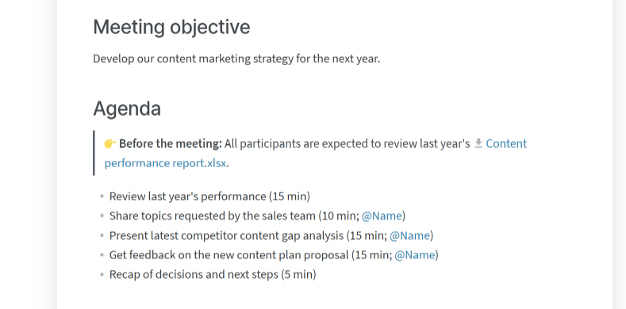
Sample agenda

Slide 15
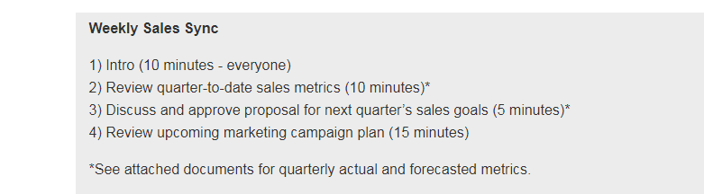
Sample agenda

Slide 16
Communicating With attendees
Inquiring about availability
Asking for agenda items
Informing the concerned participant to come prepared if s/he requires to report about a matter or manage discussion about a matter

Slide 17
Read some email message extracts and determine the writer’s purpose
I need to schedule next month's team meeting. I'd like to set up a meeting for next week.
I'm trying to arrange a meeting for sometime next week. I want to find a time for us to meet.
I'd like to propose Monday, May 2nd at 10 a.m. How about Thursday afternoon at 2:00? Would Wednesday at 9:00 work for everyone?
Here are some options, let me know what you think. Which of these days and times work for you? Let me know which of these dates you prefer.
Please let me know when you are available. When is a good time for you? Can you give me some times when you are free?

Slide 18
Writing the meeting announcement email
Write a clear subject line.
Greet the participants, e.g.
Dear All/Colleagues,
Hope you are doing well.
Provide the details of the meeting (meeting name (if any), purpose, date, time, venue).
Announce meeting agenda.
Instruct participants about any research or preparation that will be needed on their part. Also, mention names if necessary.
End with a cordial statement.

Slide 19
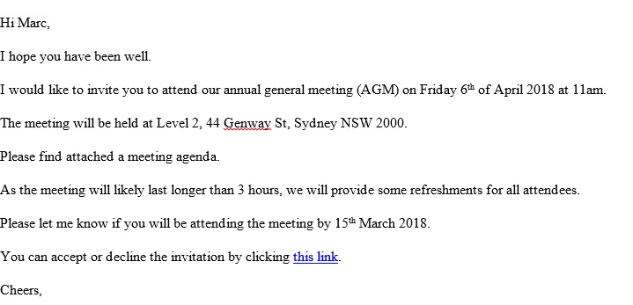
Sample email

Slide 20
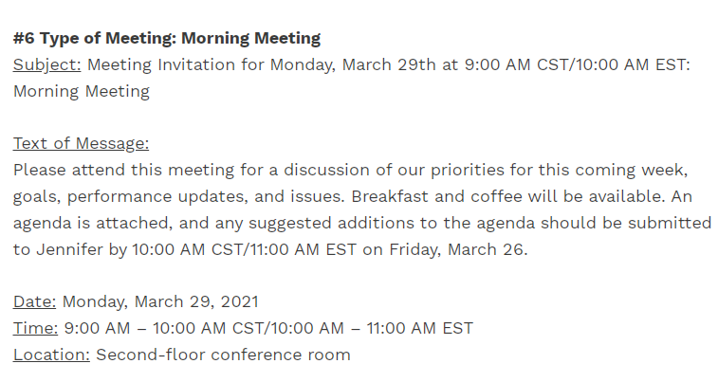
Sample email

Slide 21
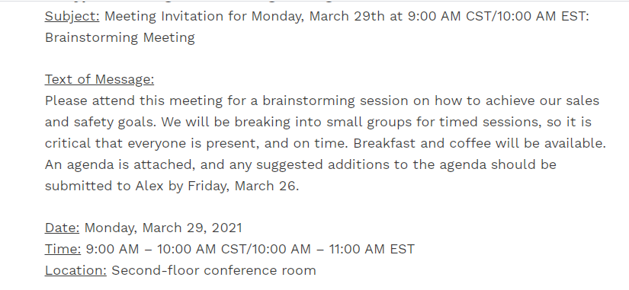
Sample email

Slide 22
Responding to meeting announcements/agenda item calls
Always respond to the meeting invite (Acknowledged/Noted with thanks).
You can suggest agenda items.
You can request for change of timings.
You can apologize for not being able to attend. But, in this case mention your genuine reason.

Slide 23
Read these responses and identify their purpose
Hi Karen, I'd like to add some time to talk about the new store. We probably need about 15 minutes.
Hi, Karen. I would like to add an item to the agenda. I think we need to discuss next month's advertising campaign. I'm not sure how long we need, but I think it's important.
Dear Lauren, I am writing to let you know that I am unable to attend next week's meeting. I have a previously scheduled appointment on that day.
Dear Lauren, I'm writing to inform you that unfortunately, I am unable to attend next week's meeting. I'm going to be out of the office on Monday. I'm on vacation all next week. My apologies. I'm sorry for any inconvenience.

Slide 24
Participating in meetings
Be an interested and useful participant
Demonstrate your abilities and competence
Read the agenda and do the homework
Arrive on time
Express opinions with tact and firmness
Support the chair in improving the quality of the discussion
Listen actively

Slide 25
Participating in meetings
Speak clearly
Avoid personal attacks
Use positive body language
Discuss, don’t argue
Take notes

Slide 26
Chairing a meeting
Introduction
Begin with roll call
State the objective of the meeting
Bring up agenda item and start discussion
Introduce participants with each other (if new)
Greet and socialize
Delegate minutes

Slide 27
Chairing a meeting
Main meeting
Encourage participation
Ask open ended questions
Ask participants by name to respond if they are inactive
Observe participants’ non-verbal feedback and identify confusions and address the issue
Summarize key points of after every agenda item for clarity and build consensus

Slide 28
Chairing a meeting
For difficult participants, keep calm and don’t lose your composure. Deal with them professionally.
Use the agenda items to keep everyone focused and avoid distractions.
Be fair and a good role-model by demonstrating work ethic.
Recognize contributors by valuing their insights.
Maintain high standards regarding discussions.
Maintain discipline by requesting participants to avoid cell phones or talking to each other.
End on time.
End with a summary of decisions and actions items.

